Slide 1

The Plug Database
Isaac Nuno-Navarro, Manahil Alqarni, Edgar Morales, Nelly Sanchez

Slide 2
Brief Description
Our database system stores and manages our employees', customer’s and inventory/product information. This database allows us to manage in-store and online electronic purchases. We offer discounts for group memberships.

Slide 3
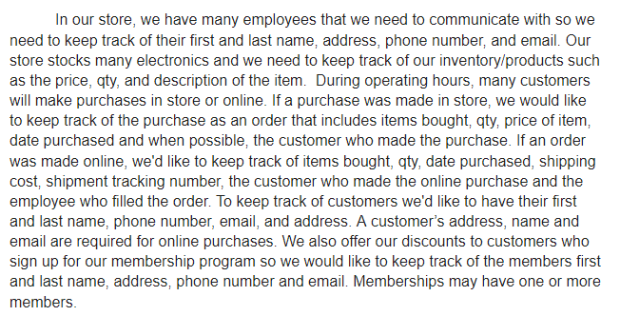
Business Rules

Slide 4
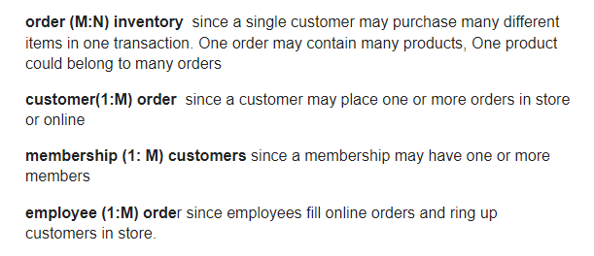
Relationships

Slide 5

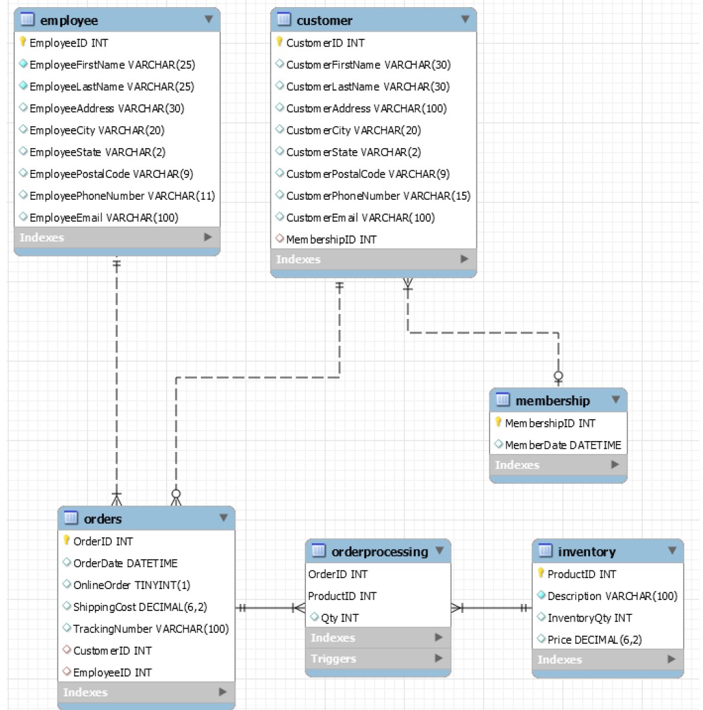
Entity-relationship diagram(ERD)

Slide 6
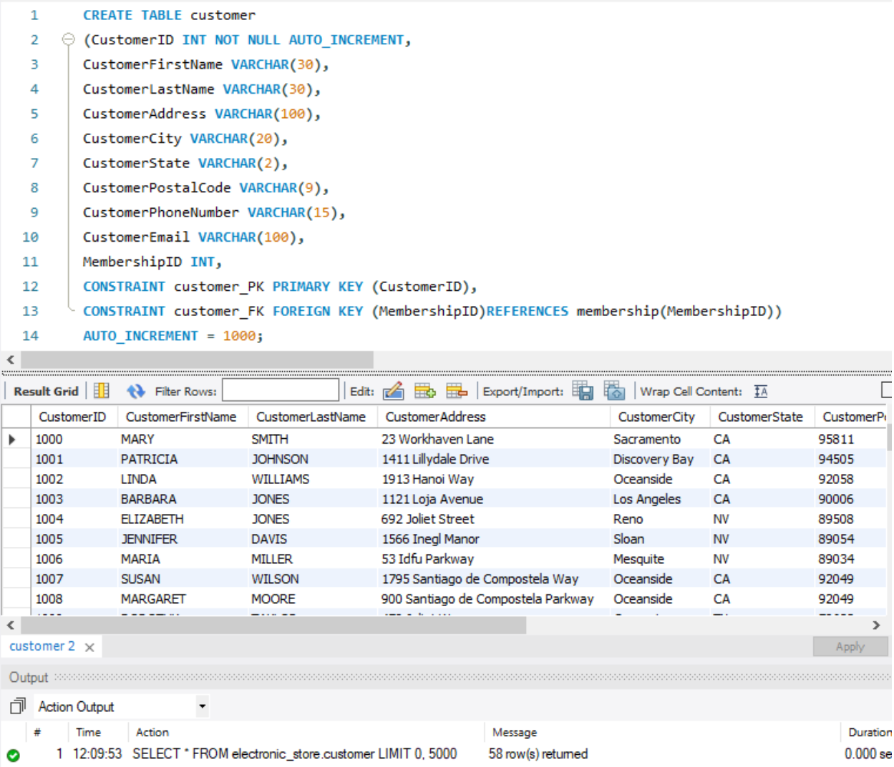
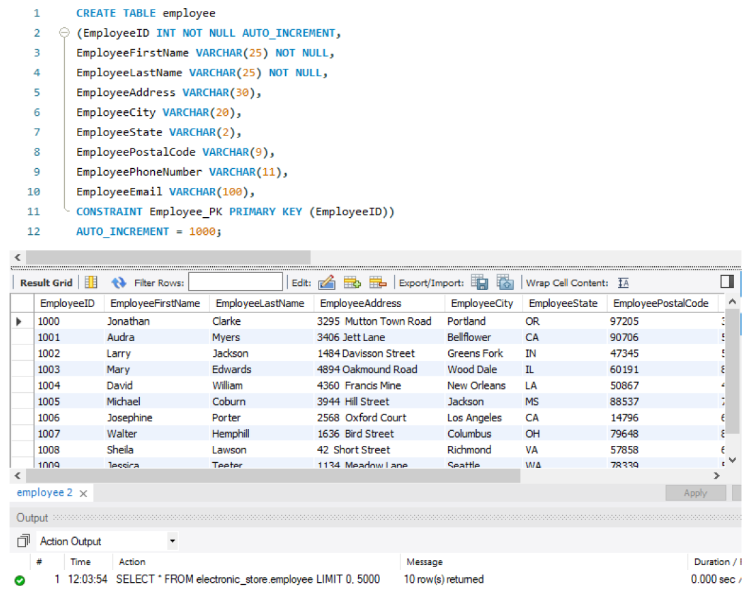
Tables
Customer Table
Employee Table

Slide 7
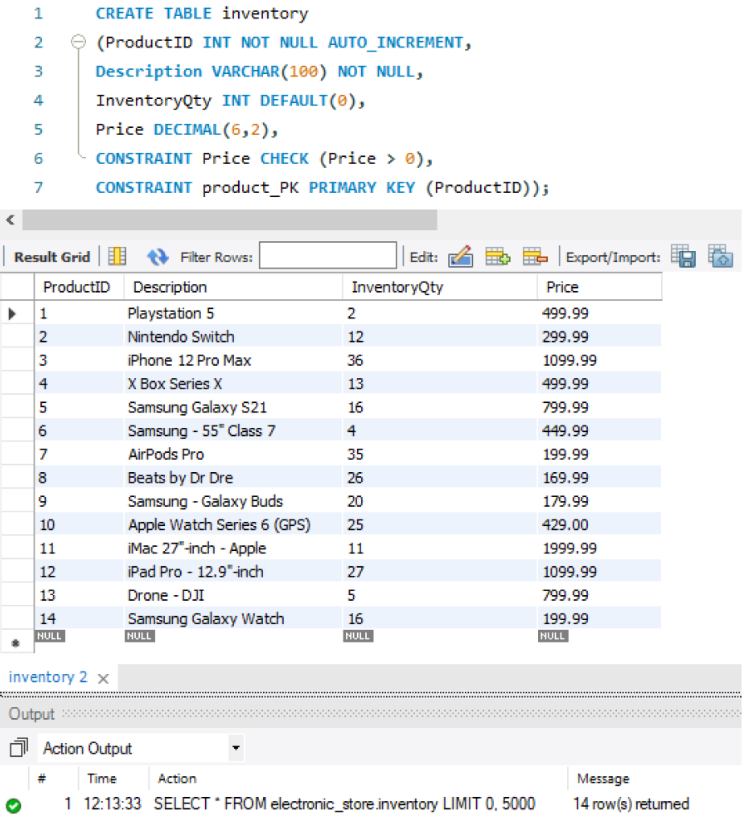
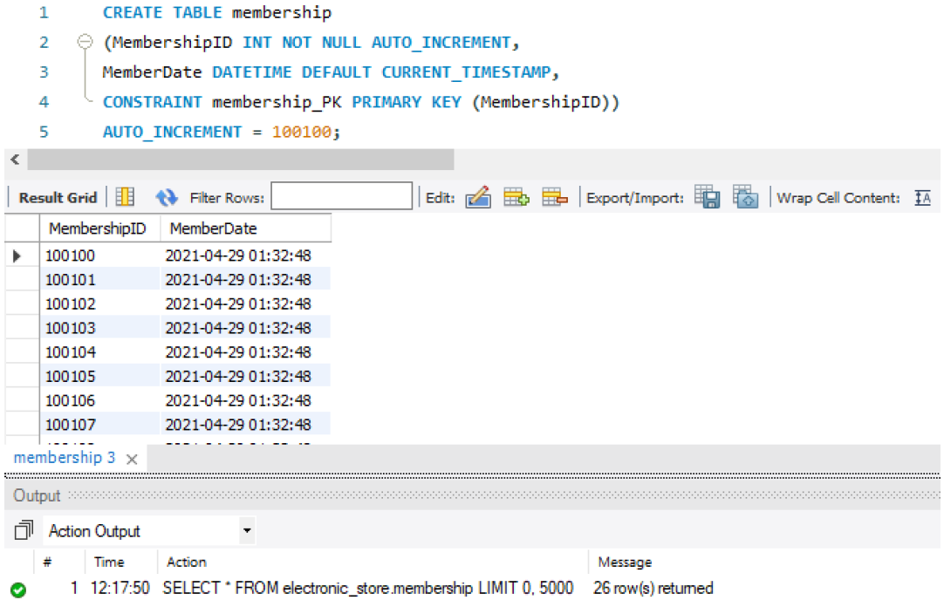
More Tables
Inventory Table
Membership Table

Slide 8
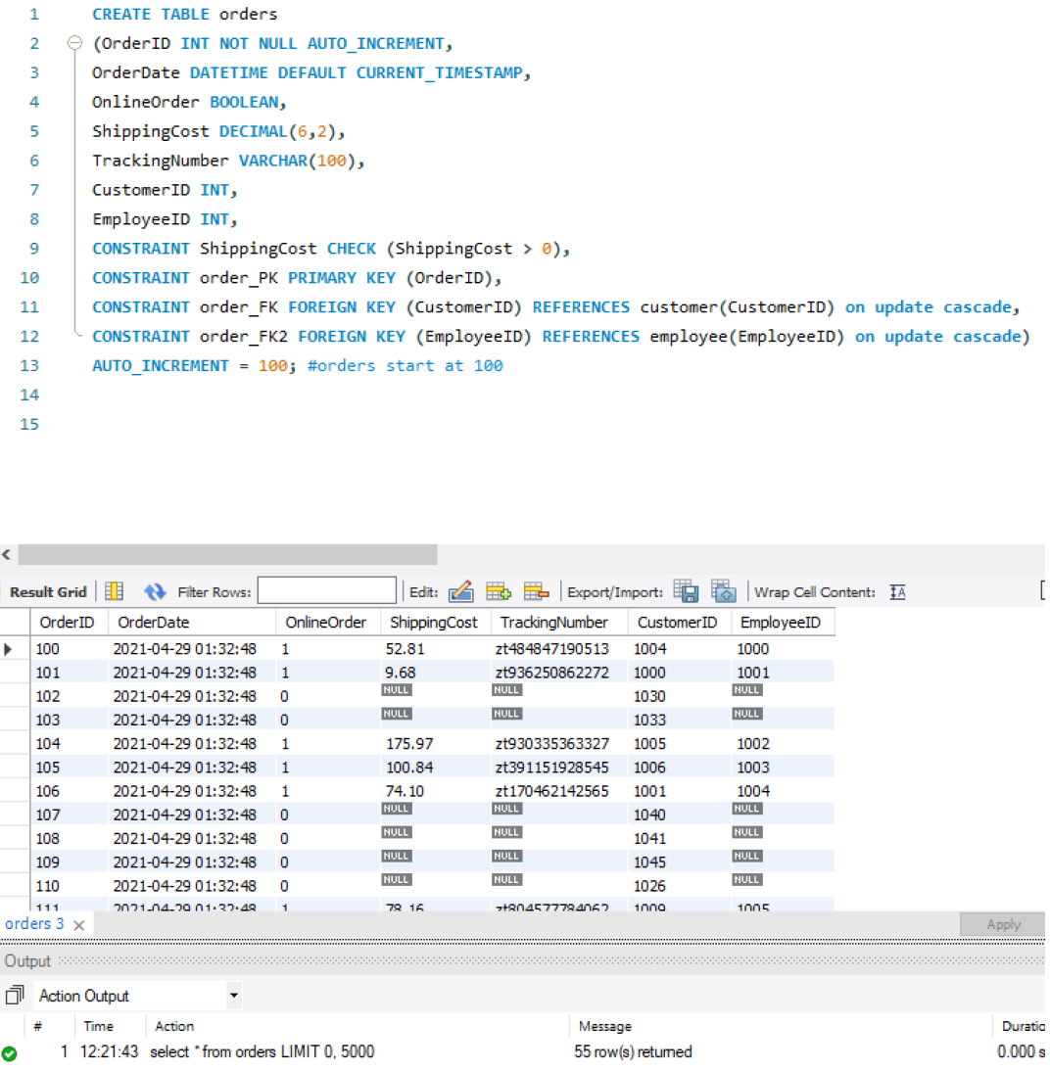
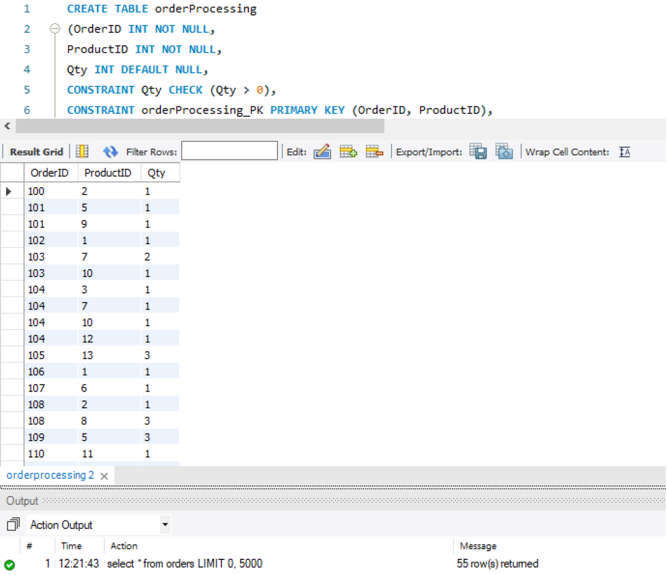
More Tables
Orders
Order Processing

Slide 9
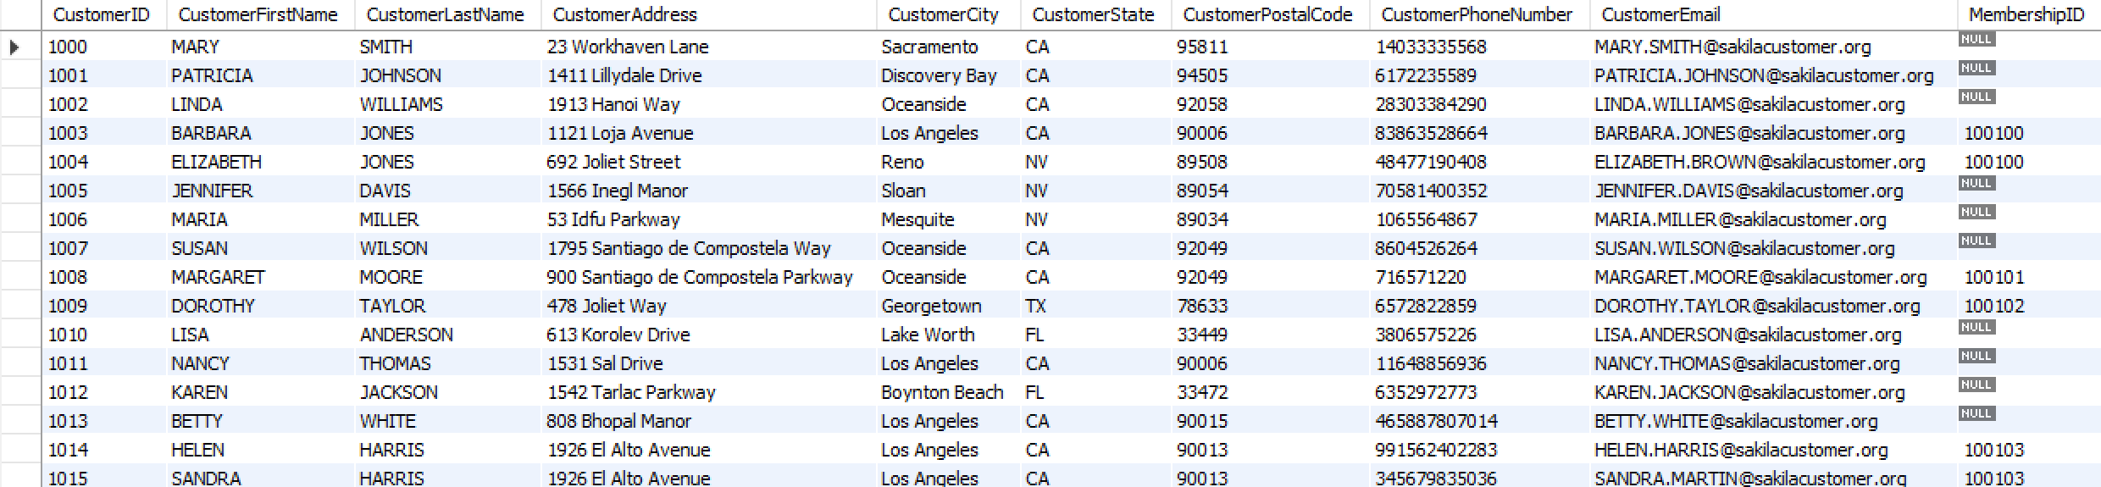
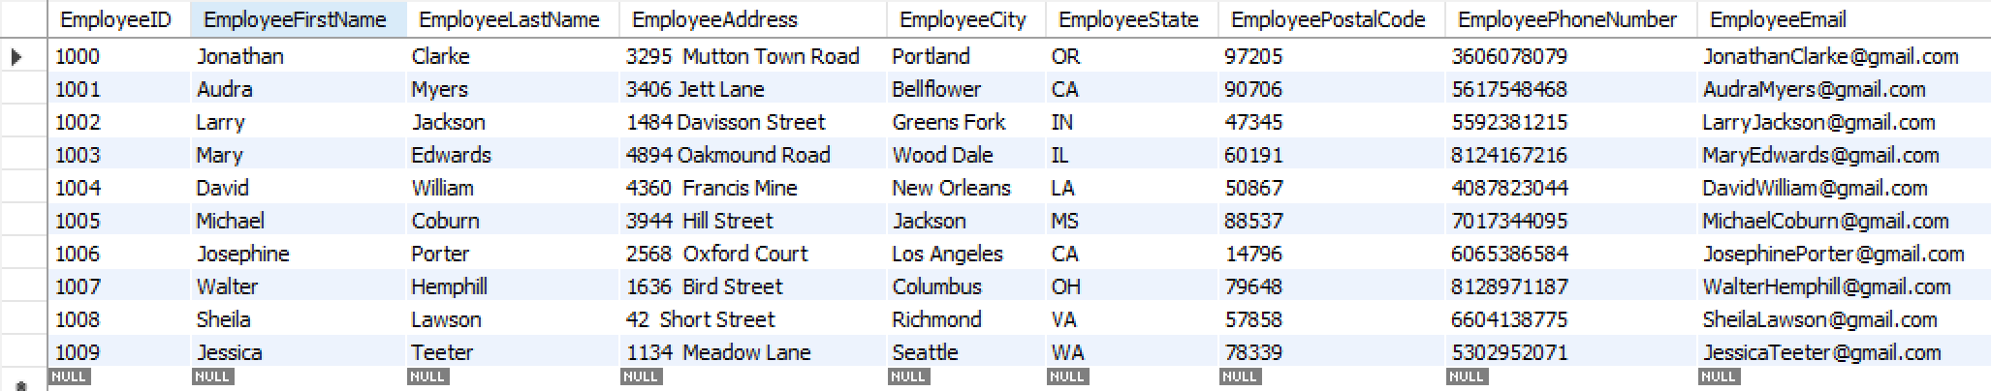
Tables
Customer Table
Employee Table

Slide 10
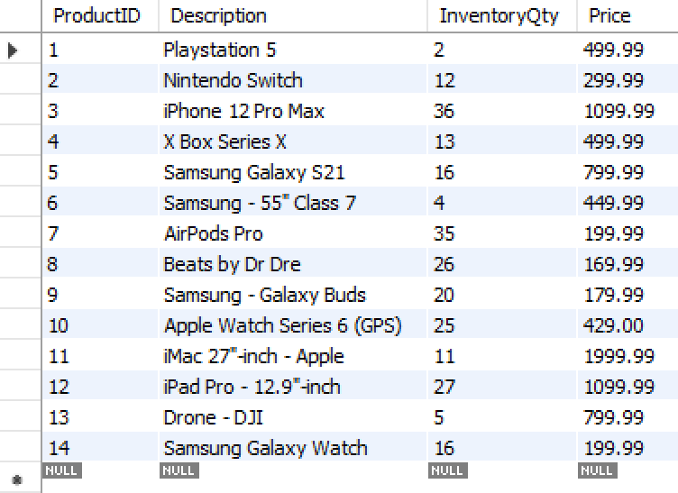
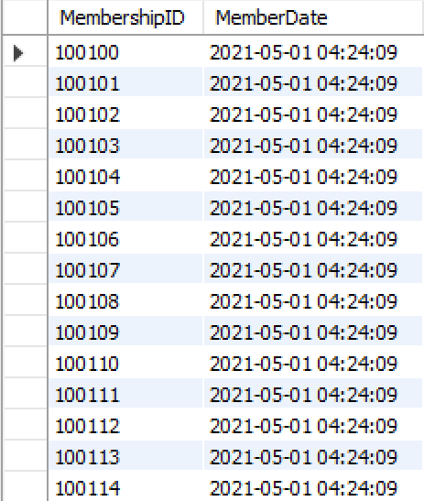
More Tables
Inventory Table
Membership Table

Slide 11
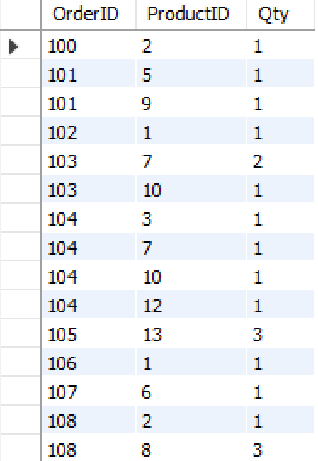
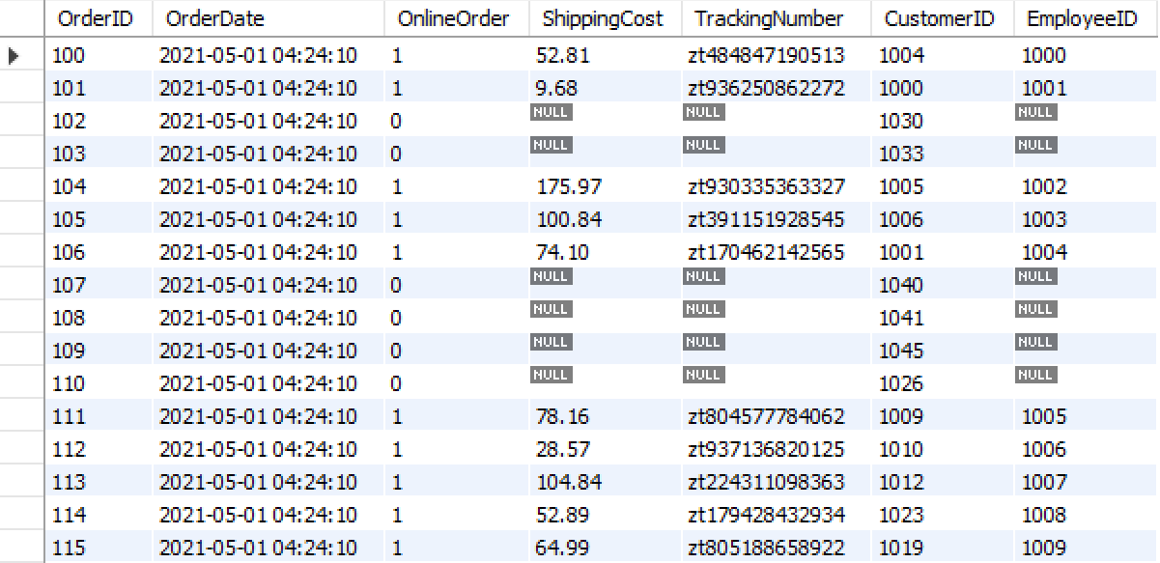
More Tables
Order Processing Table
Orders Table

Slide 12
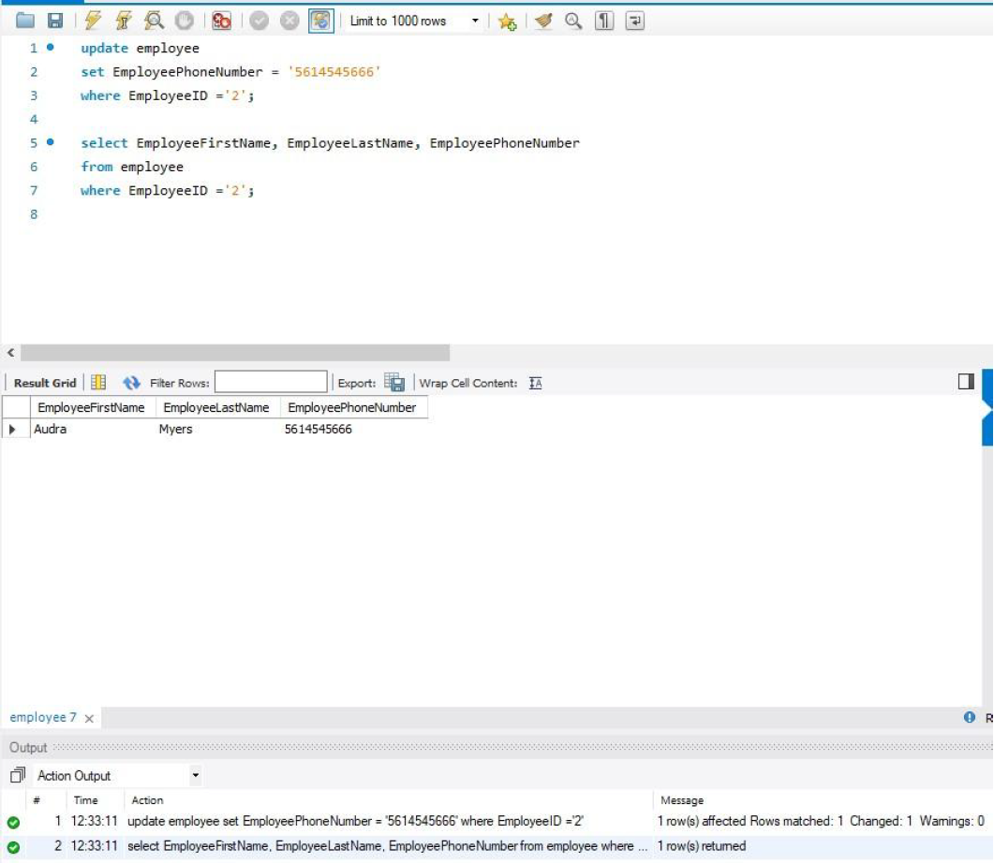
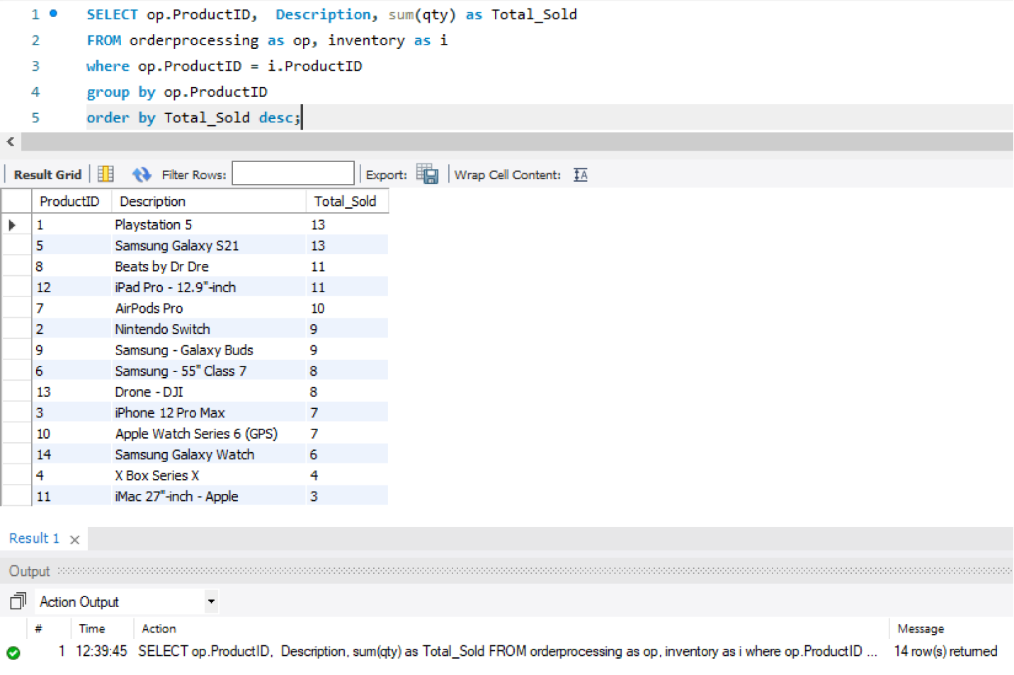
Queries
Updating
Listing products from most popular to least popular

Slide 13
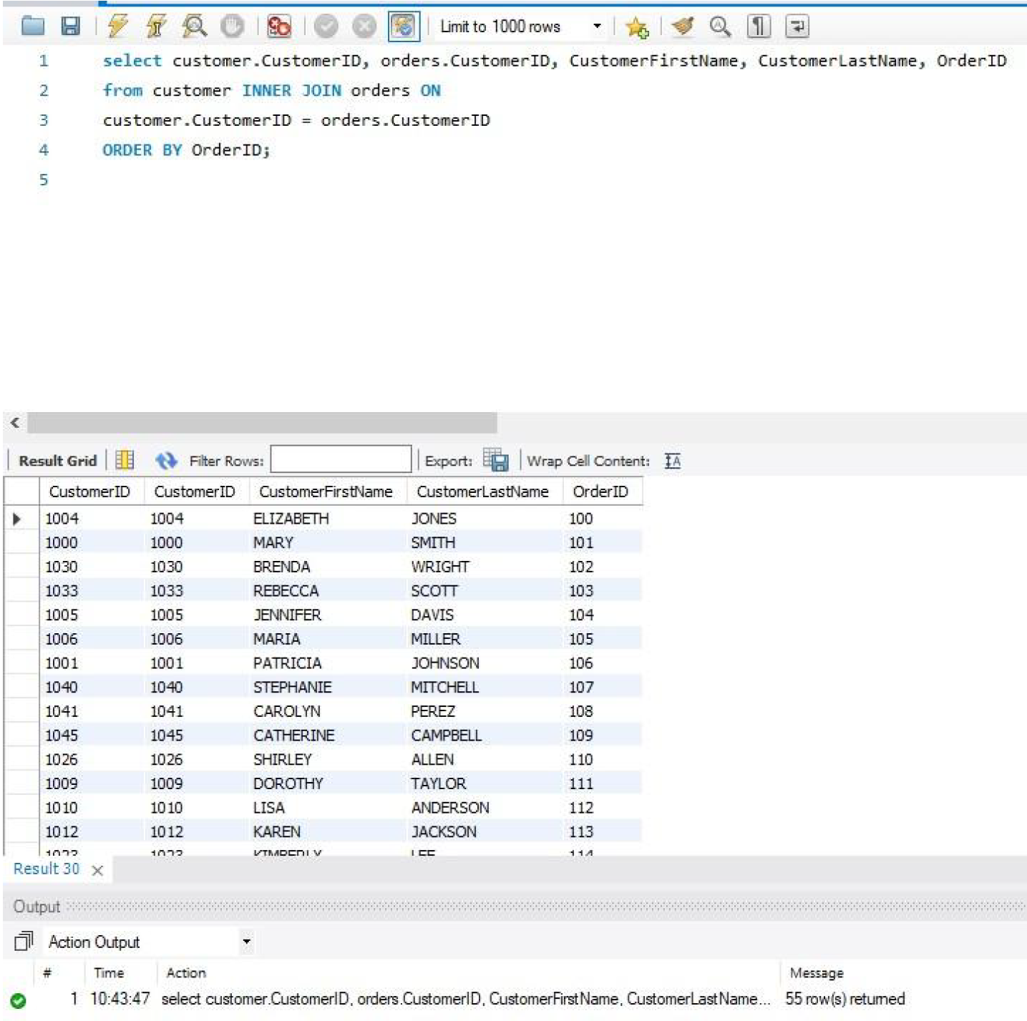
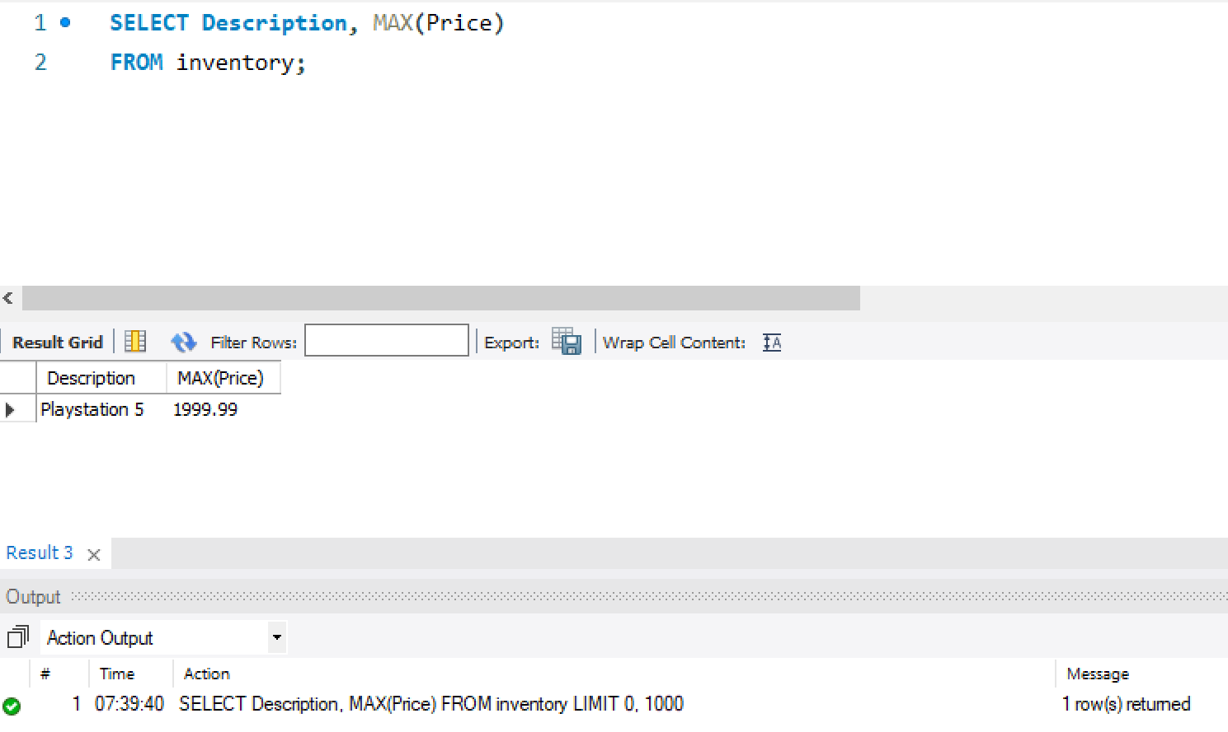
More Queries
Customer’s Name & Order Number
Most Expensive Product

Slide 14
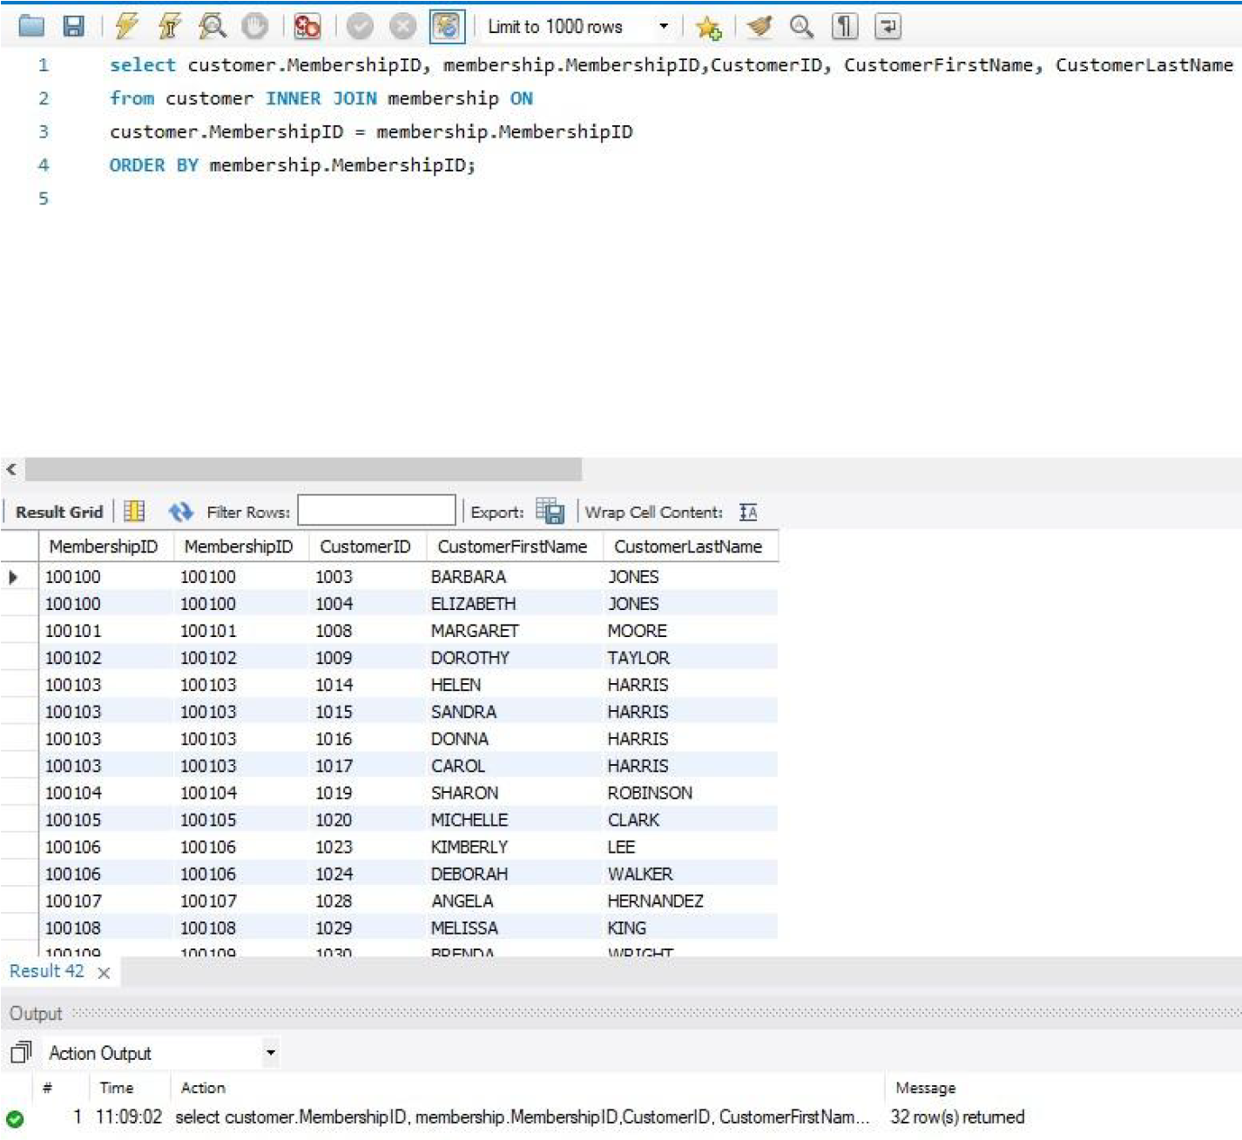
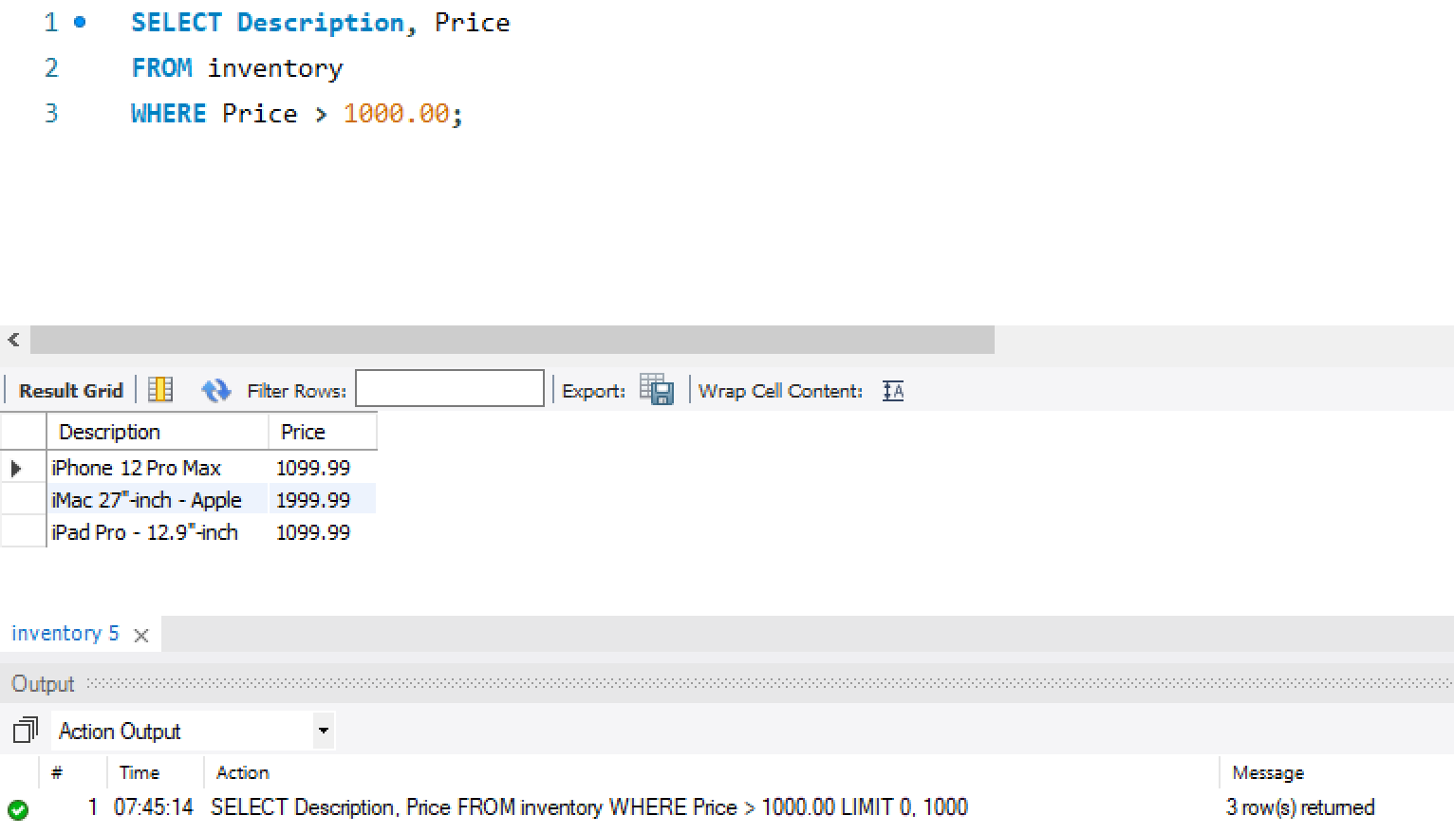
More Queries
List all customers with a membership
Products over $1,000

Slide 15
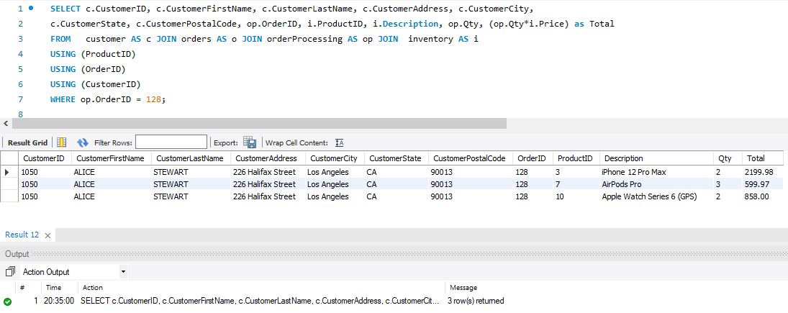
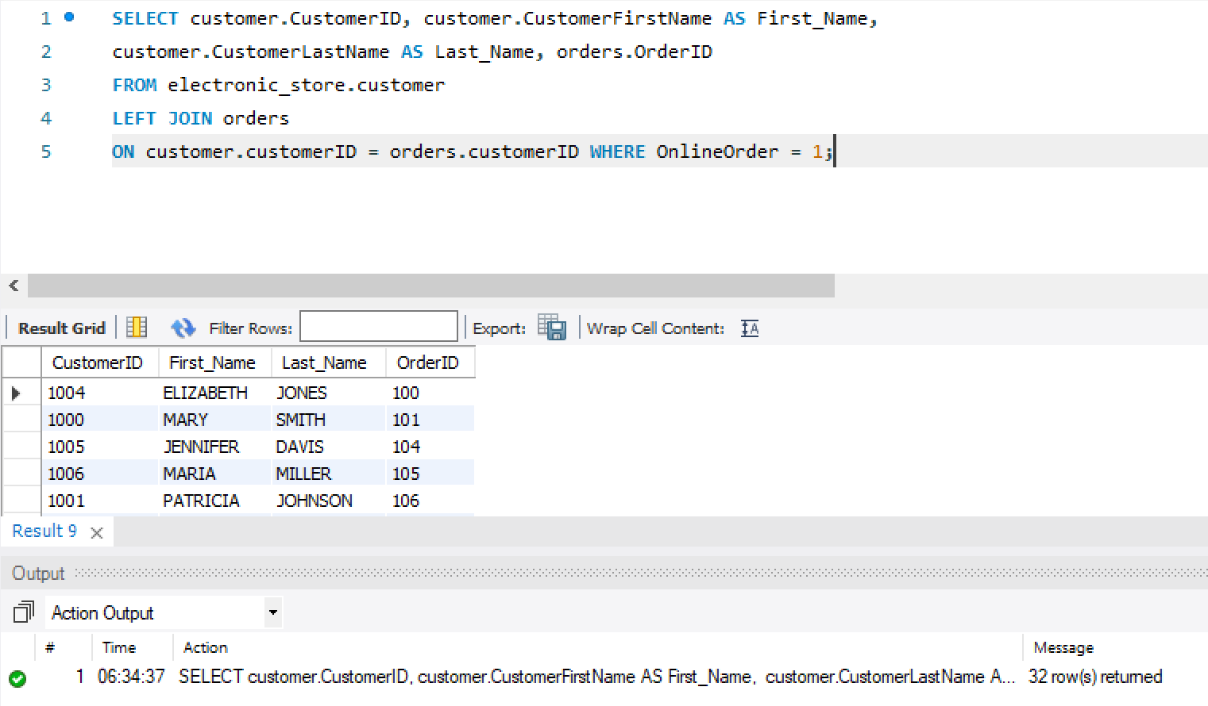
More Queries
Create an invoice
List all customer who placed online orders

Slide 16
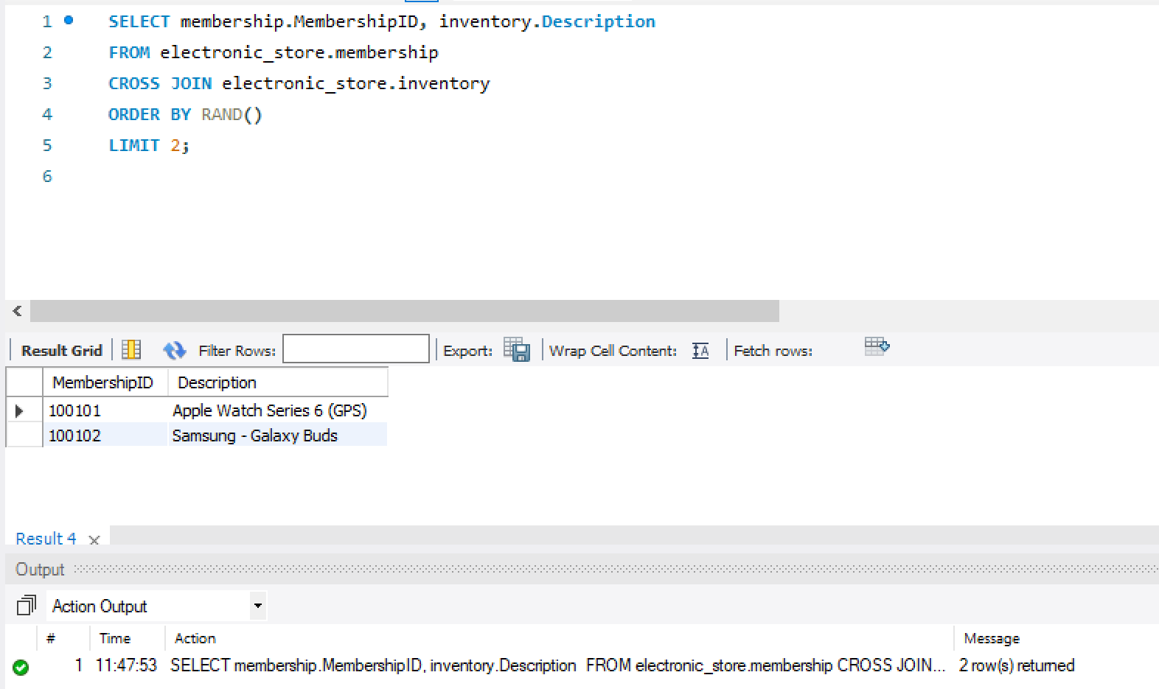
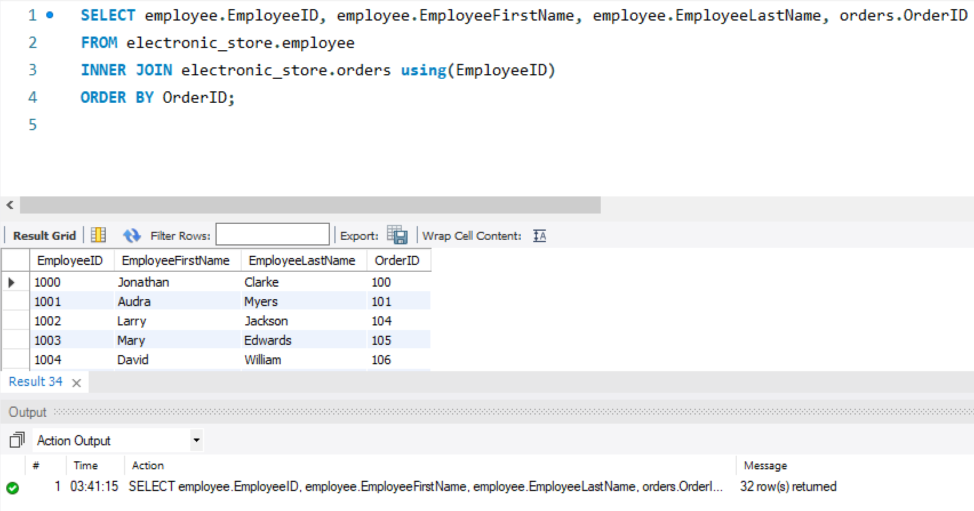
More Queries
Employee in charged of order
Raffles for our loyal members

